Slide 1
PART III
Data Link Layer

Slide 2

Position of the data-link layer

Slide 3
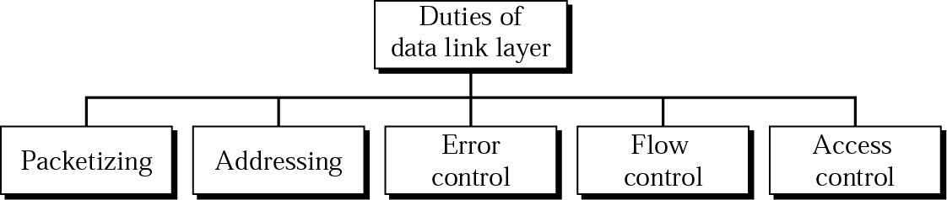
Data link layer duties

Slide 4
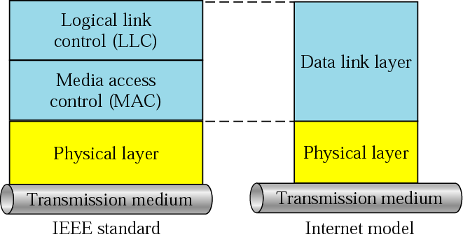
LLC and MAC sublayers

Slide 5
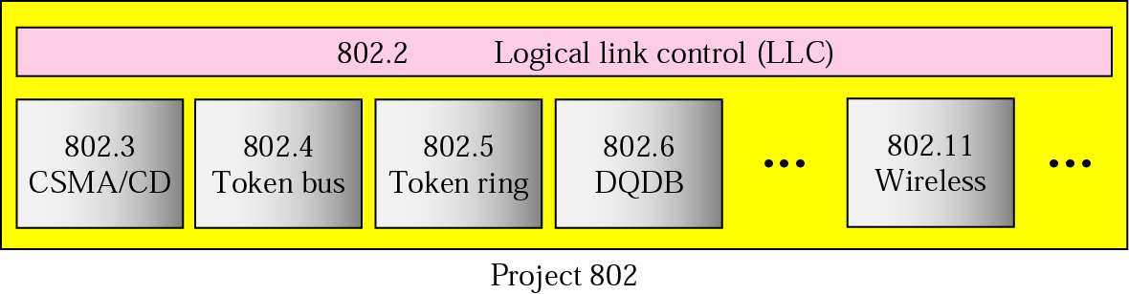
IEEE standards for LANs

Slide 6
Chapters
Chapter 10 Error Detection and Correction
Chapter 11 Data Link Control and Protocols
Chapter 12 Point-To-Point Access
Chapter 13 Multiple Access
Chapter 14 Local Area Networks
Chapter 15 Wireless LANs
Chapter 16 Connecting LANs
Chapter 17 Cellular Telephone and Satellite Networks
Chapter 18 Virtual Circuit Switching

Slide 7
10장 Error Detection and Correction
10.1 Types of Errors
10.2 Detection
10.3 Error Correction

Slide 8
Error Detection and Correction
Data can be corrupted during transmission. For reliable communication, error must be detected and corrected
Error Detection and Correction are implemented either at the data link layer or the transport layer of the OSI model

Slide 9
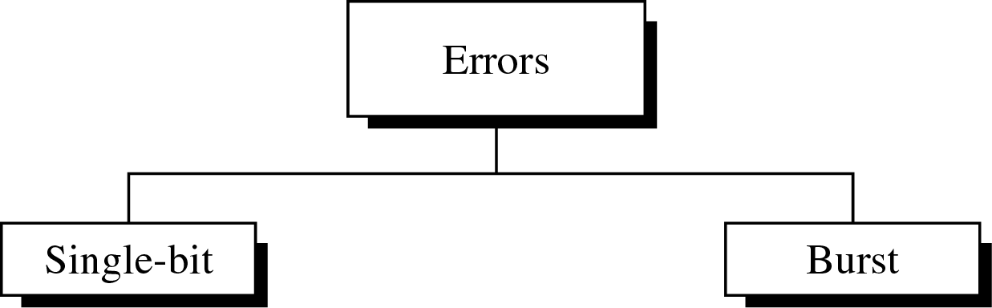
10.1 Type of Errors

Slide 10
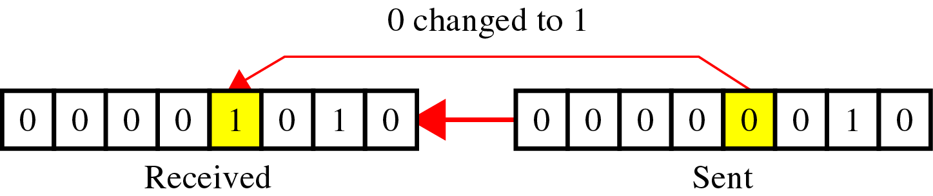
Type of Errors(cont’d)
Single-Bit Error
~ is when only one bit in the data unit has changed (ex : ASCII STX - ASCII LF)

Slide 11
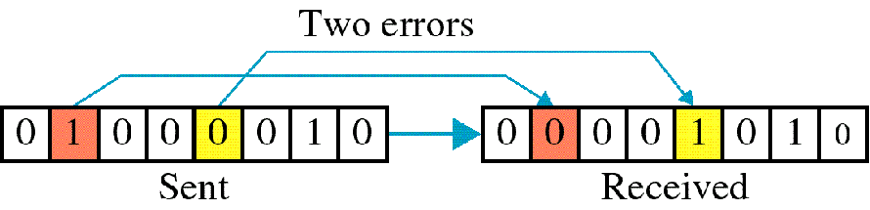
Type of Errors(cont’d)
Multiple-Bit Error
~ is when two or more nonconsecutive bits in the data unit have changed(ex : ASCII B - ASCII LF)

Slide 12
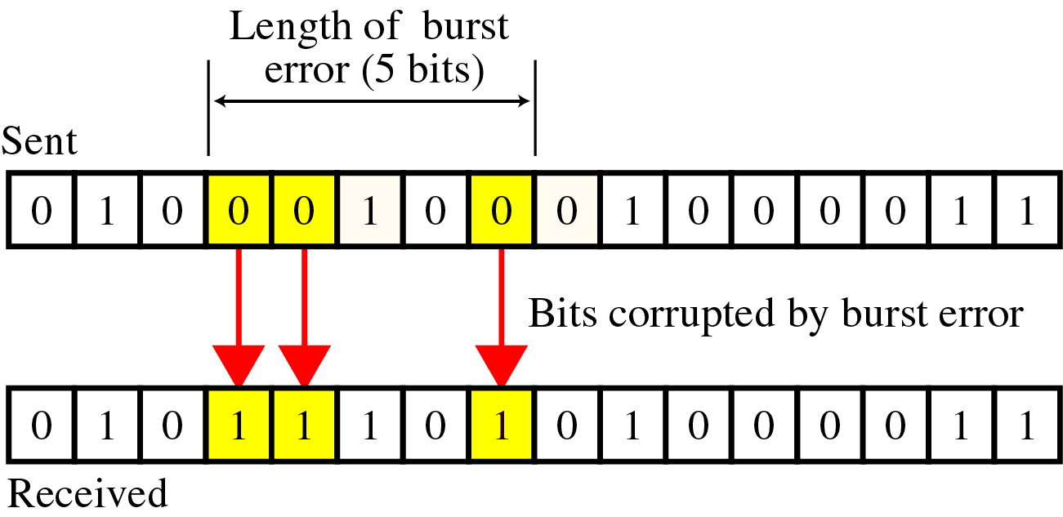
Type of Errors(cont’d)
Burst Error
~ means that 2 or more consecutive bits in the data unit have changed

Slide 13
10.2 Detection
Error detection uses the concept of redundancy, which means adding extra bits for detecting errors at the destination

Slide 14
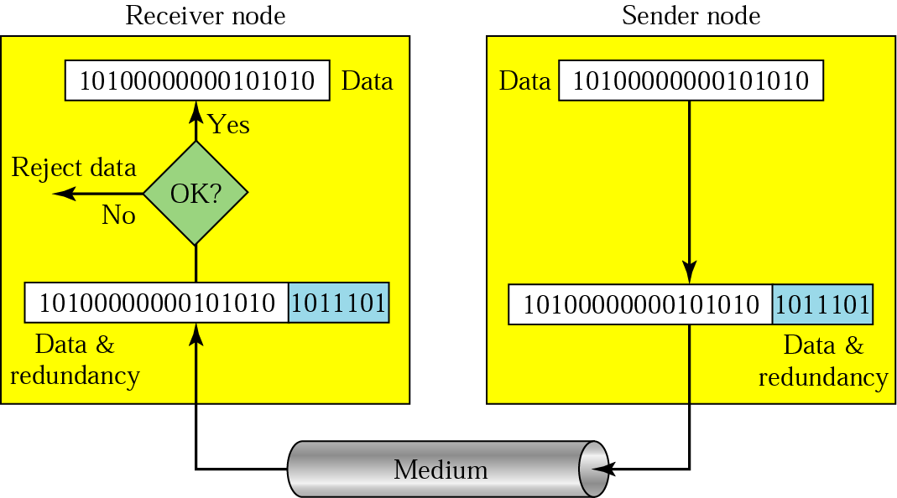
Detection(cont’d)
Redundancy

Slide 15
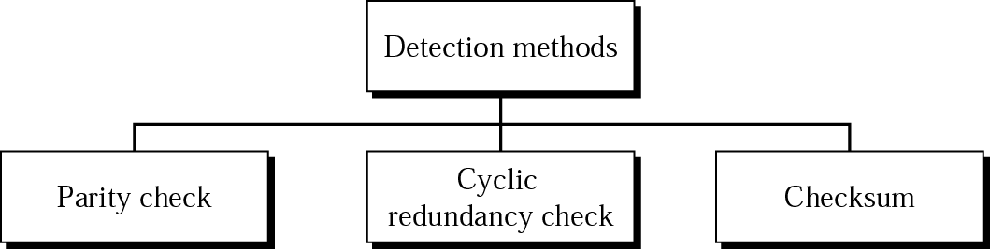
Detection(cont’d)
Detection methods

Slide 16
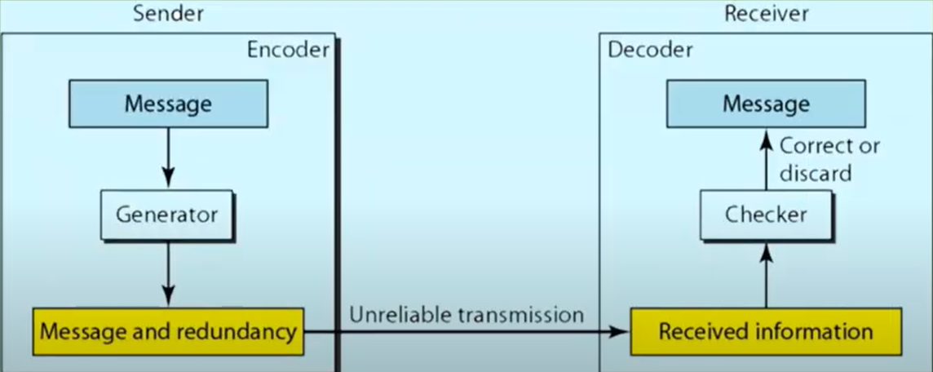

Slide 17
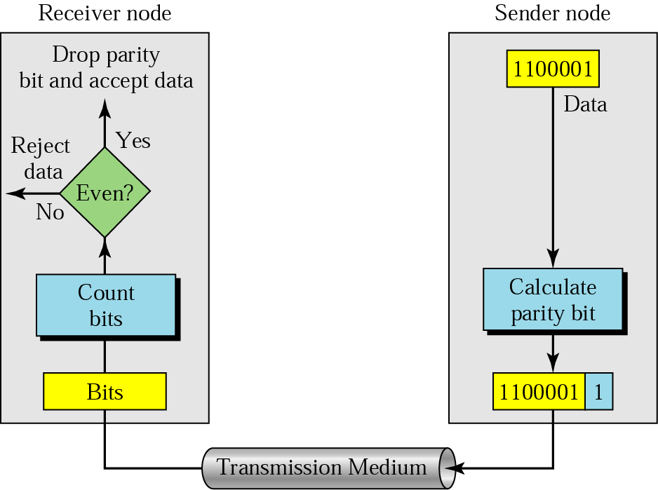
Detection(cont’d)
Parity Check
  A parity bit is added to every data unit so that the total number of 1s(including the parity bit) becomes even for even-parity check or odd for odd-parity check
  Simple parity check

Slide 18
Detection -examples
Example 1
Suppose the sender wants to send the word world. In ASCII the five characters are coded as
1110111 1101111 1110010 1101100 1100100
The following shows the actual bits sent
11101110 11011110 11100100 11011000 11001001

Slide 19
Detection – examples
Example 2
Now suppose the word world in Example 1 is received by the receiver without being corrupted in transmission.
11101110 11011110 11100100 11011000 11001001
The receiver counts the 1s in each character and comes up with even numbers (6, 6, 4, 4, 4). The data are accepted.

Slide 20
Detection – examples
Example 3
Now suppose the word world in Example 1 is corrupted during transmission.
11111110 11011110 11101100 11011000 11001001
The receiver counts the 1s in each character and comes up with even and odd numbers (7, 6, 5, 4, 4). The receiver knows that the data are corrupted, discards them, and asks for retransmission.

Slide 21
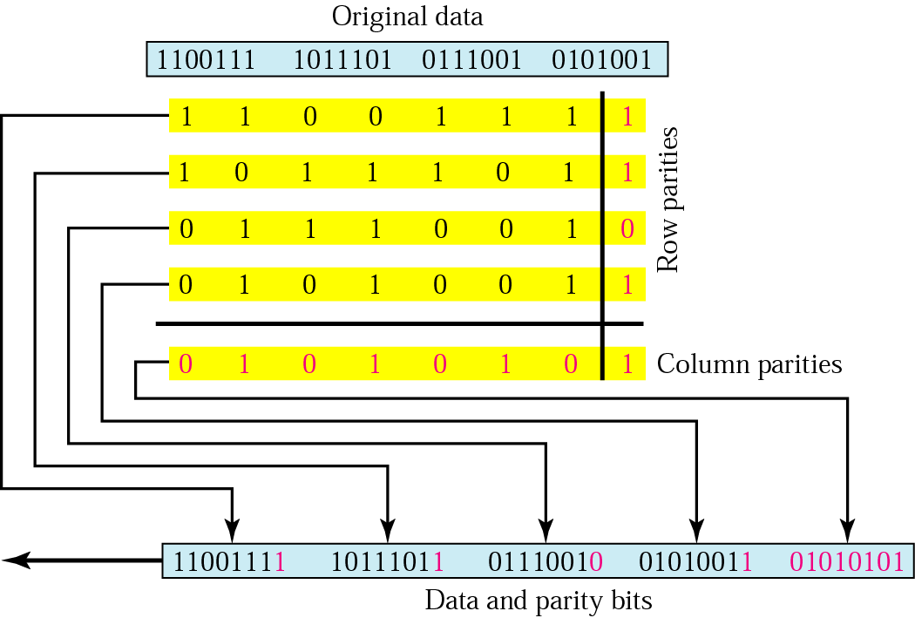
Two –Dimensional Parity Check

Slide 22
Detection - example
Example 4
Suppose the following block is sent:
10101001 00111001 11011101 11100111 10101010
However, it is hit by a burst noise of length 8, and some bits are corrupted.
10100011 10001001 11011101 11100111 10101010
When the receiver checks the parity bits, some of the bits do not follow the even-parity rule and the whole block is discarded.
10100011 10001001 11011101 11100111 10101010

Slide 23
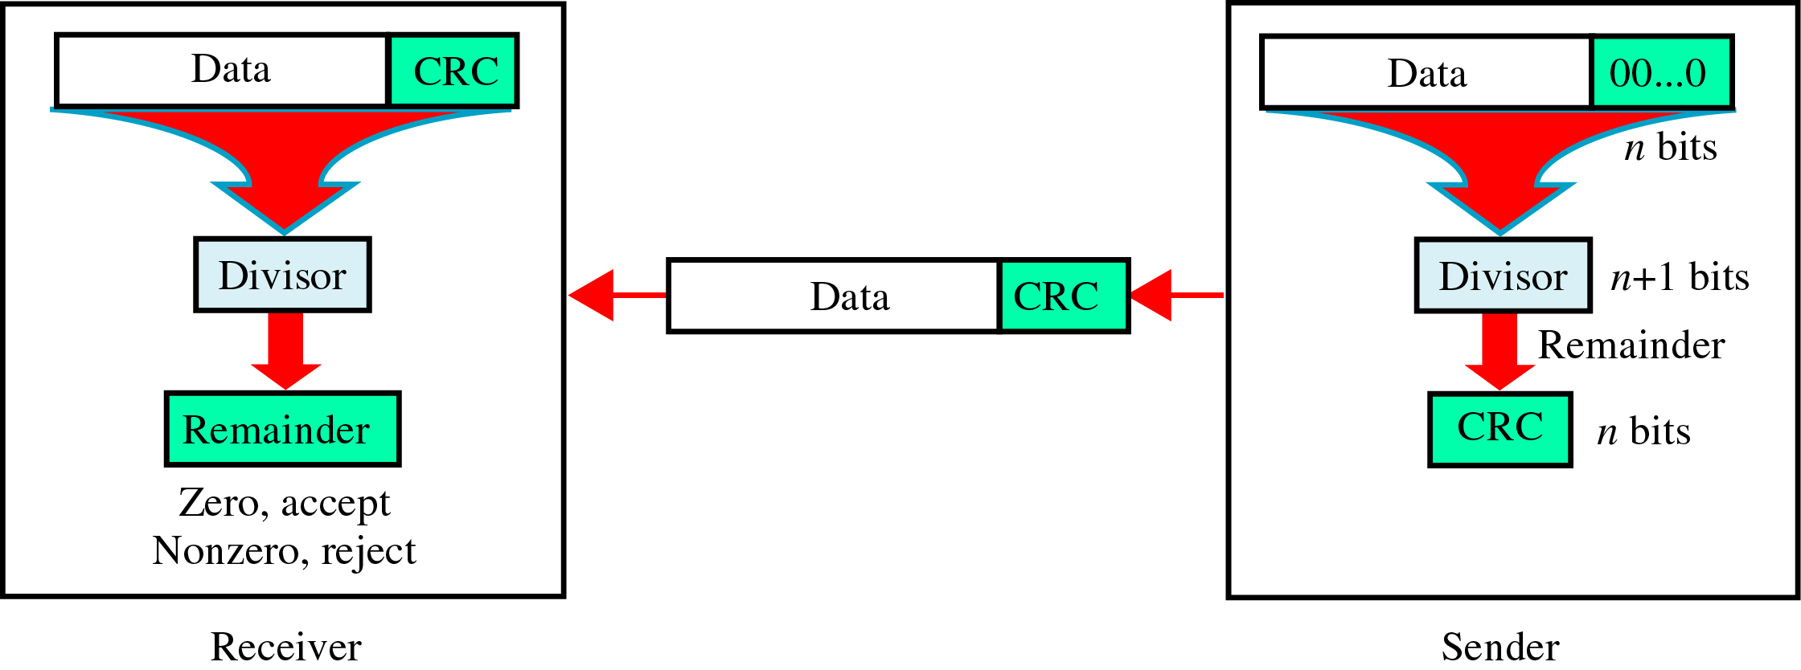
Detection(cont’d)
CRC(Cyclic Redundancy Check)
~ is based on binary division.

Slide 24
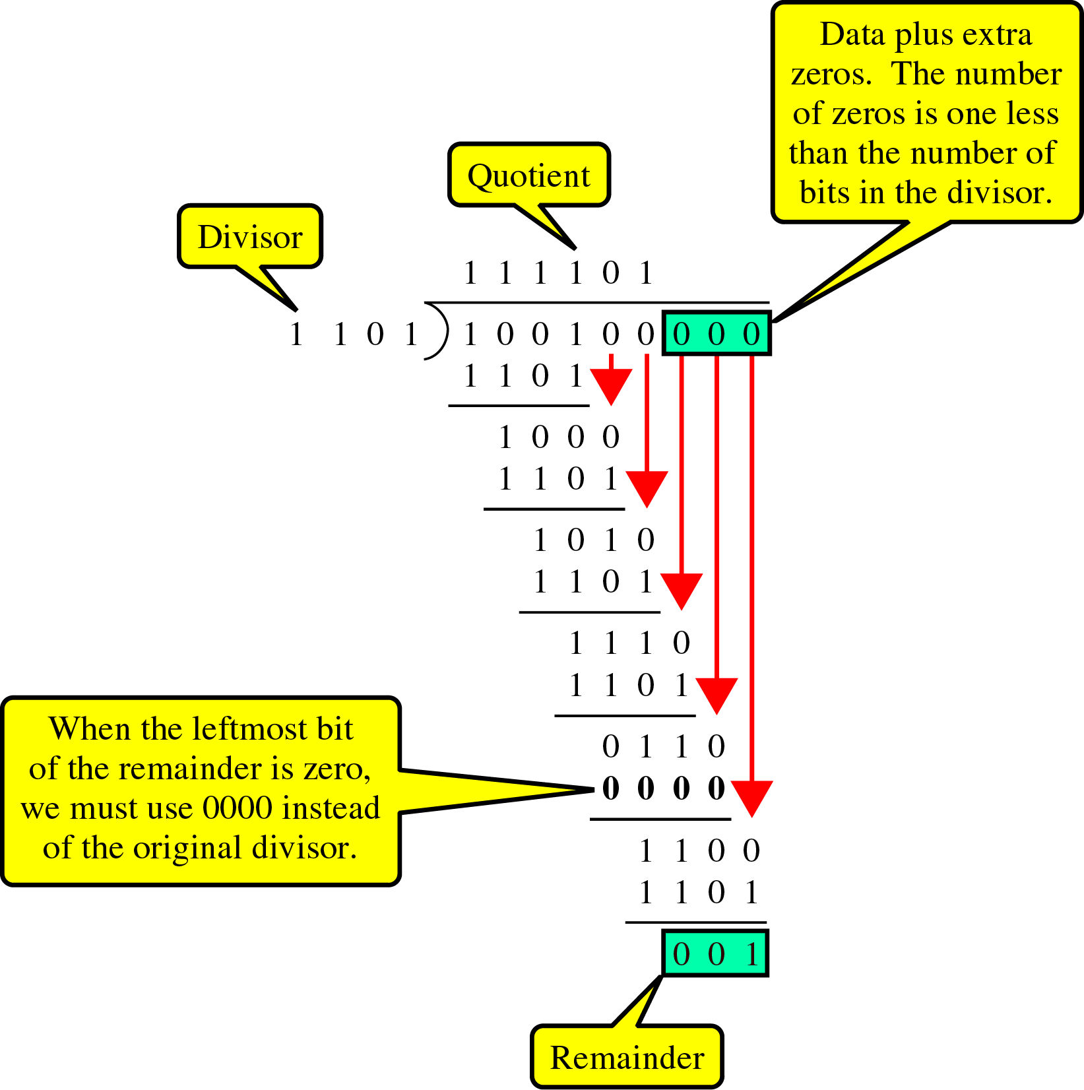
Detection(cont’d)
CRC generator
~ uses modular-2 division.
Binary Division
in a
CRC Generator

Slide 25
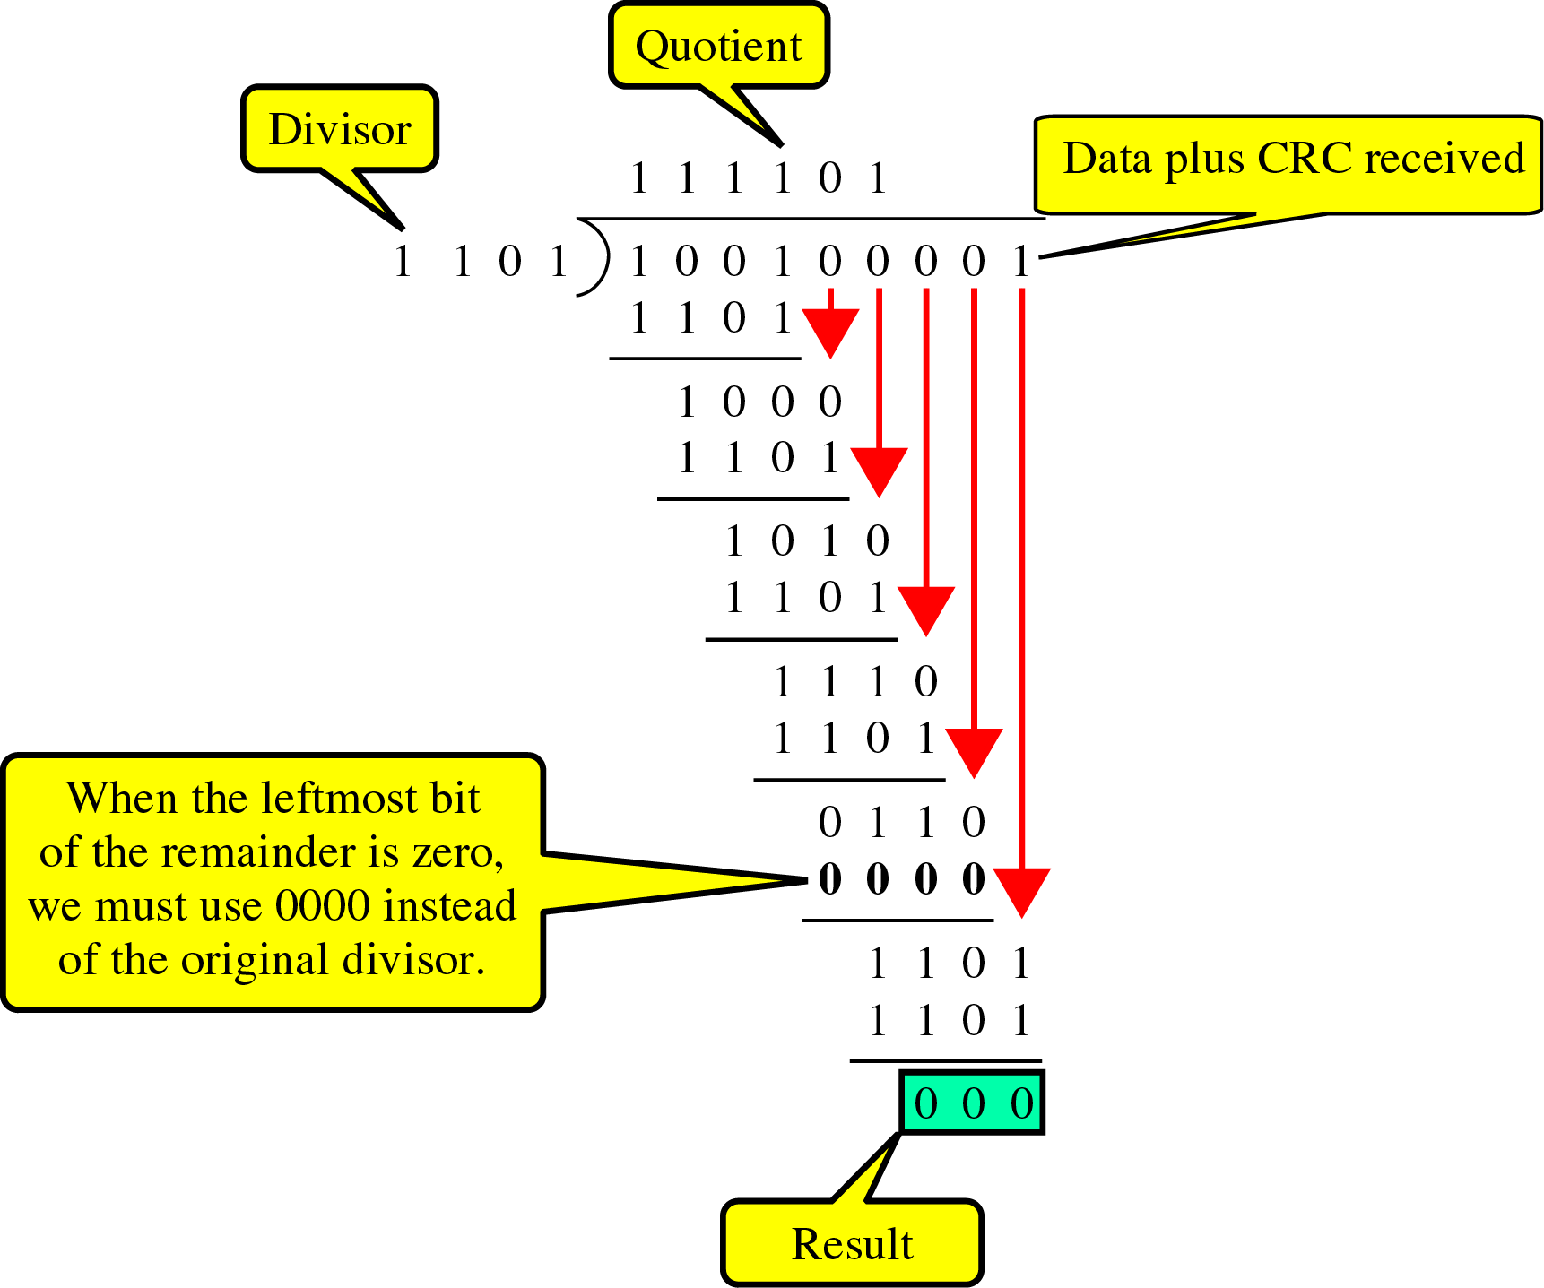
Detection(cont’d)
Binary Division
in a
CRC Checker

Slide 26
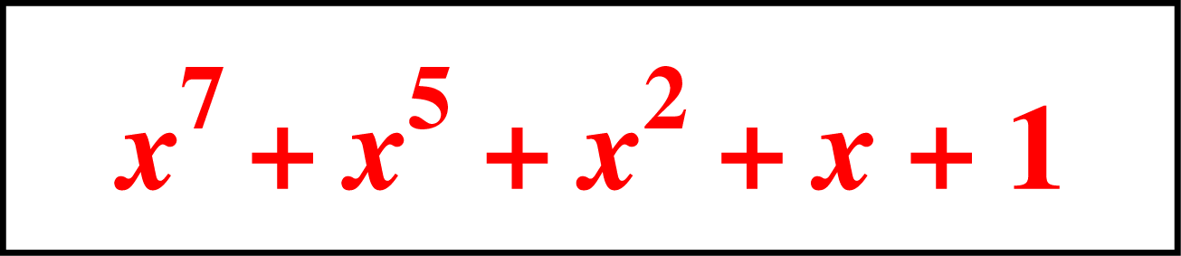
Detection(cont’d)
Polynomials
  CRC generator(divisor) is most often represented not as a string of 1s and 0s, but as an algebraic polynomial.

Slide 27
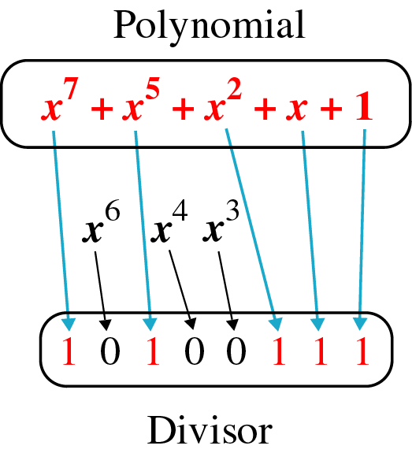
Detection(cont’d)
A polynomial representing a divisor

Slide 28
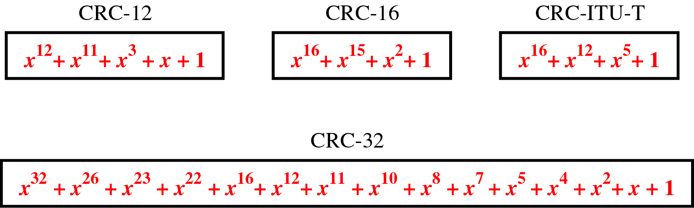
Detection(cont’d)
Standard polynomials

Slide 29
Detection(cont’d)
Checksum
~ used by the higher layer protocols
~ is based on the concept of redundancy(VRC, LRC, CRC ….)

Slide 30
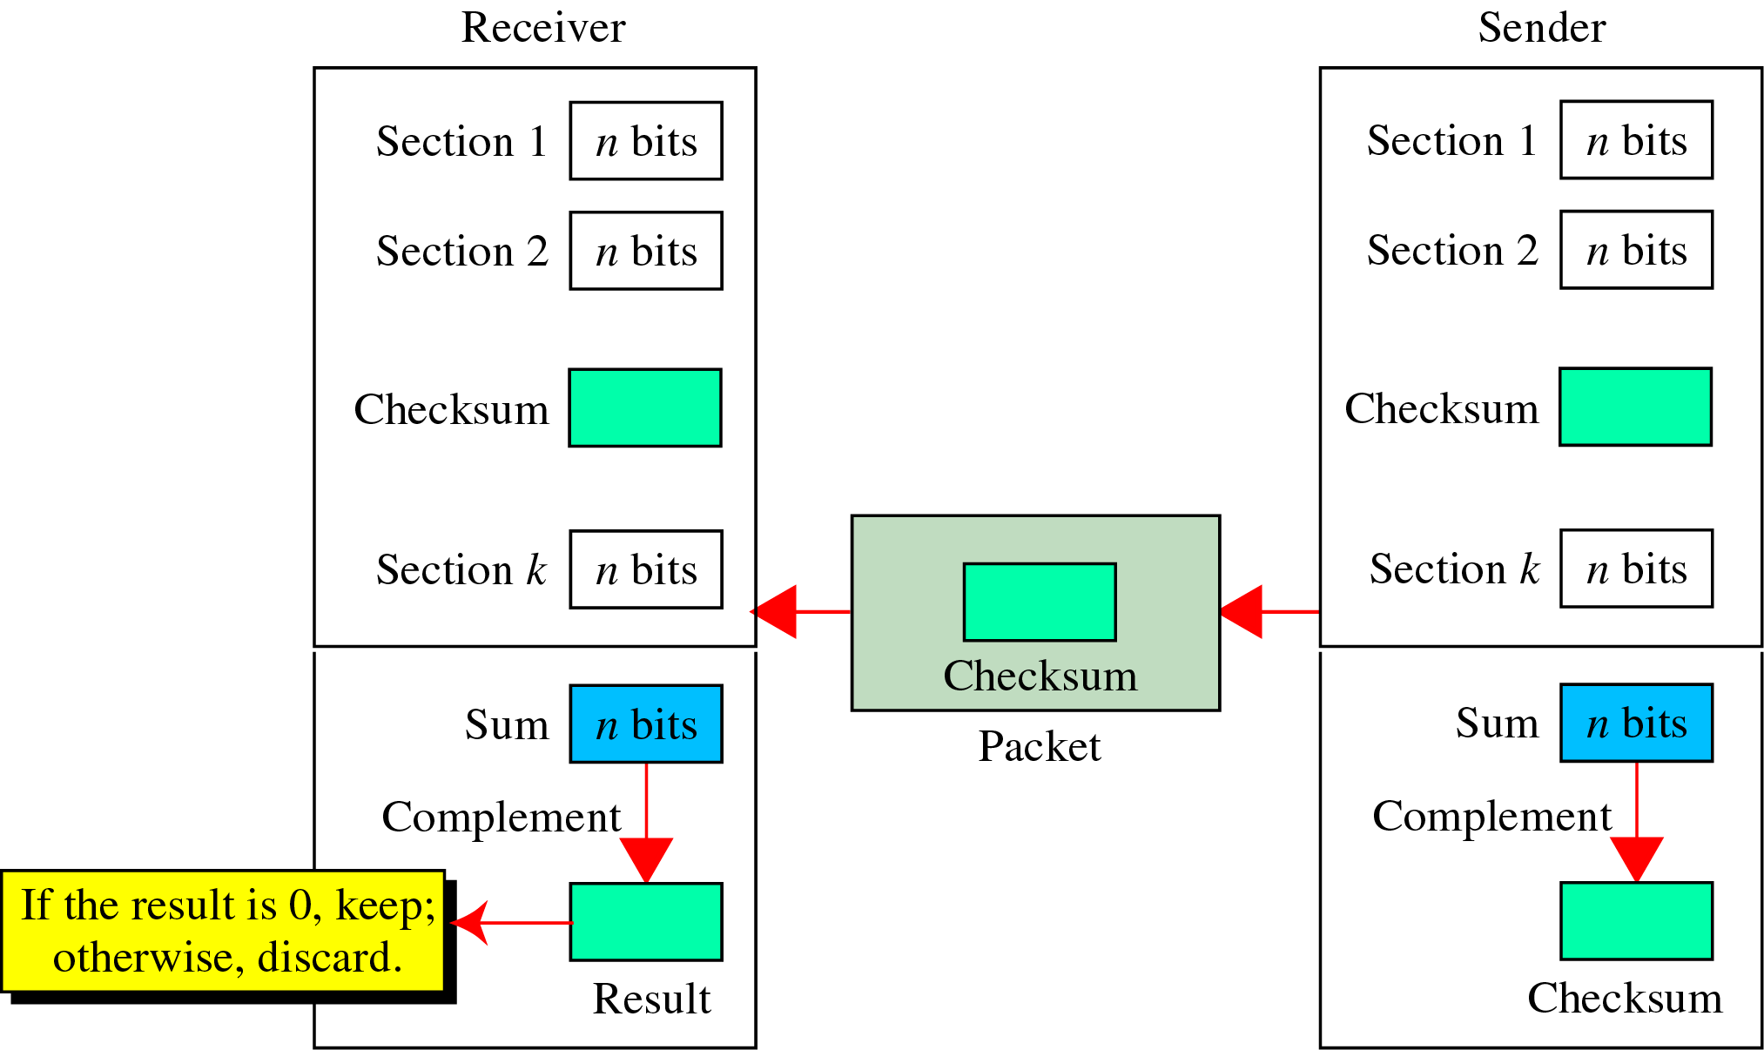
Detection(cont’d)
Checksum Generator

Slide 31
Detection(cont’d)
To create the checksum the sender does the following:
  The unit is divided into K sections, each of n bits.
  Section 1 and 2 are added together using one’s complement.
  Section 3 is added to the result of the previous step.
  Section 4 is added to the result of the previous step.
  The process repeats until section k is added to the result of the previous step.
  The final result is complemented to make the checksum.

Slide 32
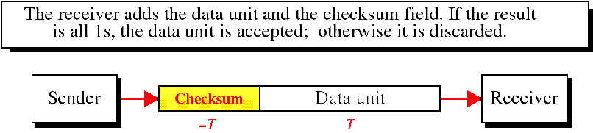
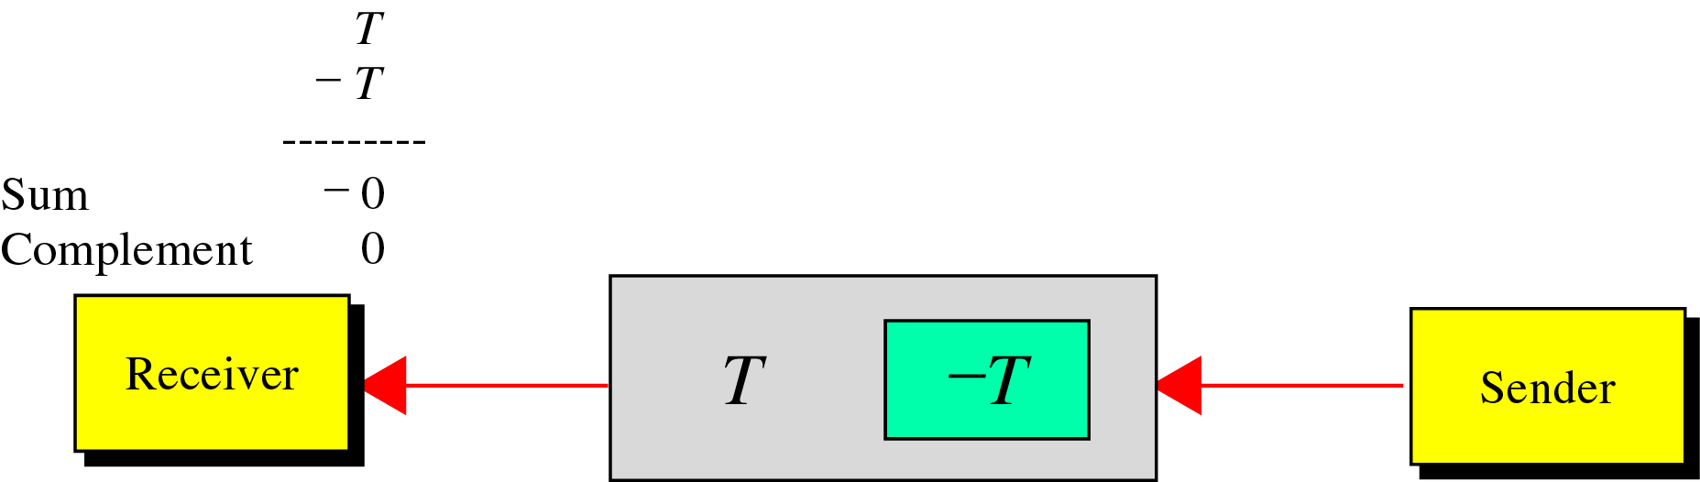
Detection(cont’d)
data unit and checksum

Slide 33
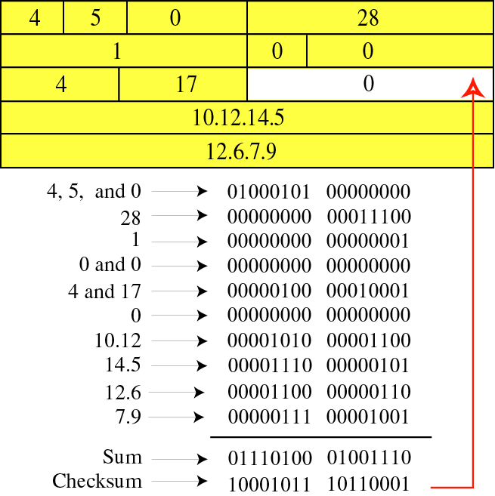
Detection(cont’d)

Slide 34
Detection(cont’d)
예제 9.7 ( at a sender)
Original data : 10101001 00111001
10101001
00111001
--------------
11100010 Sum
00011101 Checksum
10101001 00111001 00011101 ← 전송

Slide 35
Detection(cont’d)
Example ( at a receiver)
Received data : 10101001 00111001 00011101
10101001
00111001
00011101
---------------
11111111 ← Sum
00000000 ← Complement

Slide 36
10.3 Error Correction
~ can be handled in two ways
✶ when an error is discovered, the receiver can have the sender retransmit the entire data unit.
✴ a receiver can use an error-correcting code, which automatically corrects certain errors.

Slide 37
Error Correction(cont’d)
Single-Bit Error Correction
  parity bit
  The secret of error correction is to locate the invalid bit or bits
  For ASCII code, it needs a three-bit redundancy code(000-111)

Slide 38
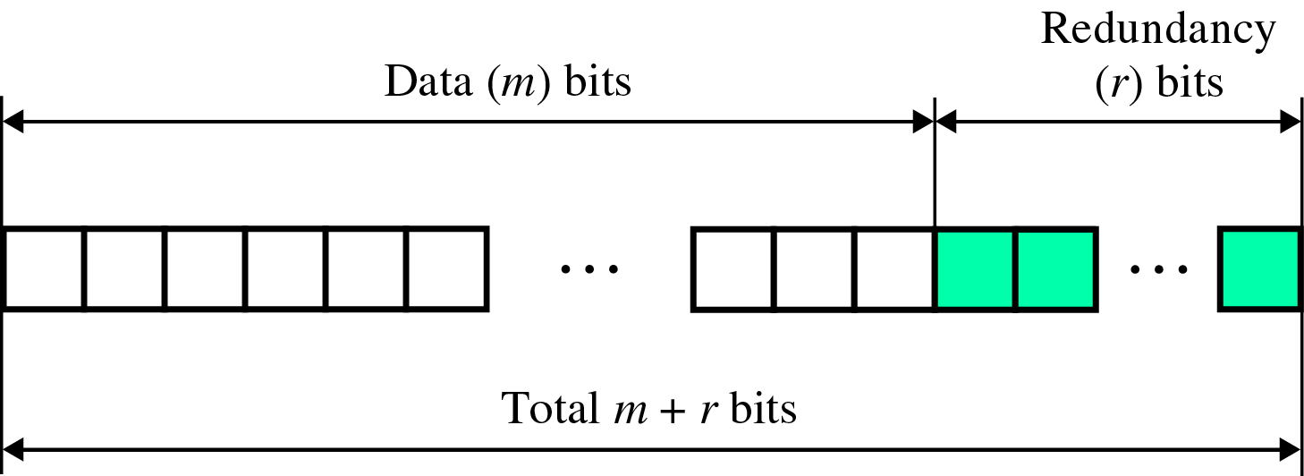
Error Correction(cont’d)
Redundancy Bits
~ to calculate the number of redundancy bits (R) required to correct a given number of data bit (M)

Slide 39
Error Correction(cont’d)
If the total number of bits in a transmittable unit is m+r, then r must be able to indicate at least m+r+1 different states
2^{r} ≥ m + r + 1
ex) For value of m is 7(ASCII), the smallest r value that can satisfy this equation is 4
2⁴ ≥ 7 + 4 + 1

Slide 40
Error Correction(cont’d)
Relationship between data and redundancy bits
Number of Data Bits
(m)
Number of Redundancy Bits
(r)
Total Bits
(m+r)
1
2
3
4
5
6
7
2
3
3
3
4
4
4
3
5
6
7
9
10
11

Slide 41
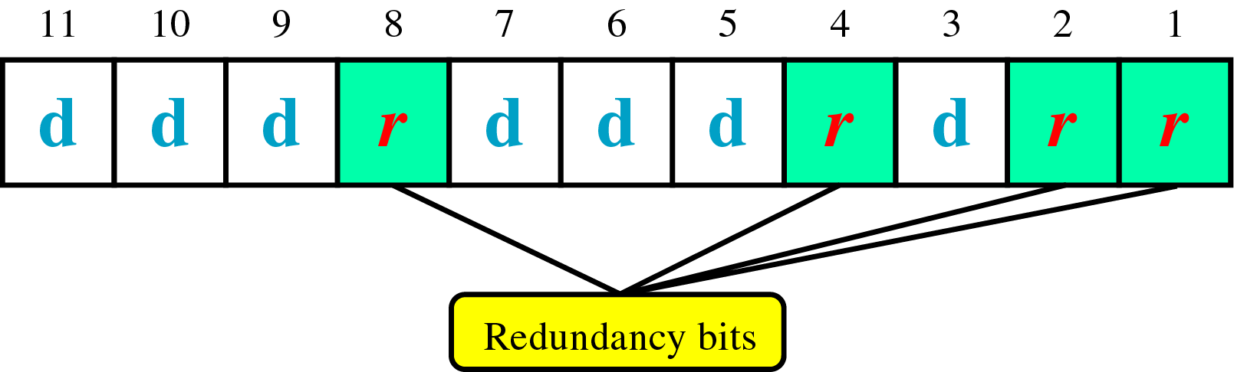
Error Correction(cont’d)
Hamming Code
~ developed by R.W.Hamming
positions of redundancy bits in Hamming code

Slide 42
Error Correction(cont’d)
each r bit is the VRC bit for one combination of data bits
  r₁ = bits 1, 3, 5, 7, 9, 11
  r₂ = bits 2, 3, 6, 7, 10, 11
  r₄ = bits 4, 5, 6, 7
  r₈ = bits 8, 9, 10, 11

Slide 43
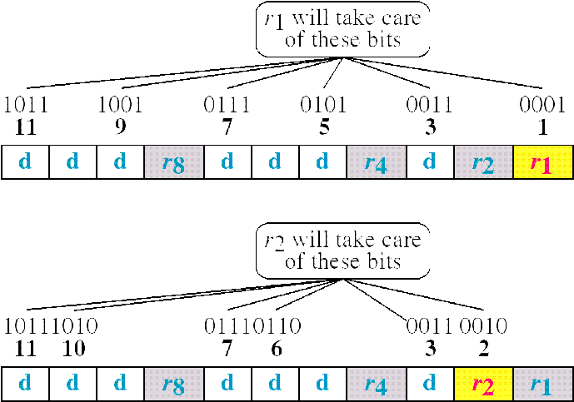
Error Correction(cont’d)
Redundancy bits calculation(cont’d)

Slide 44
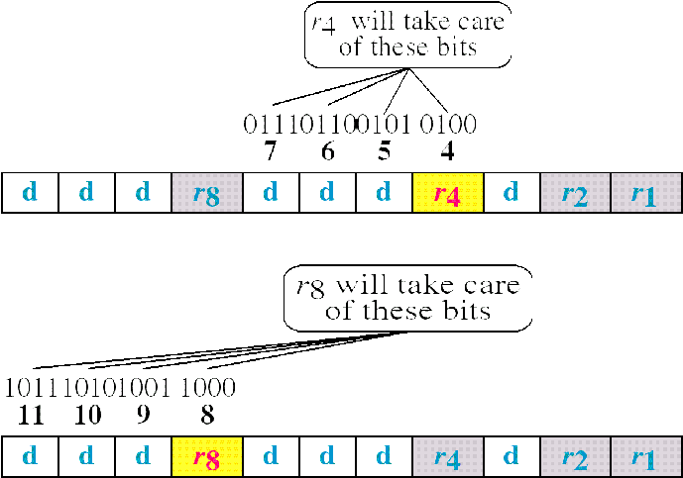
Error Correction(cont’d)
Redundancy bits calculation

Slide 45
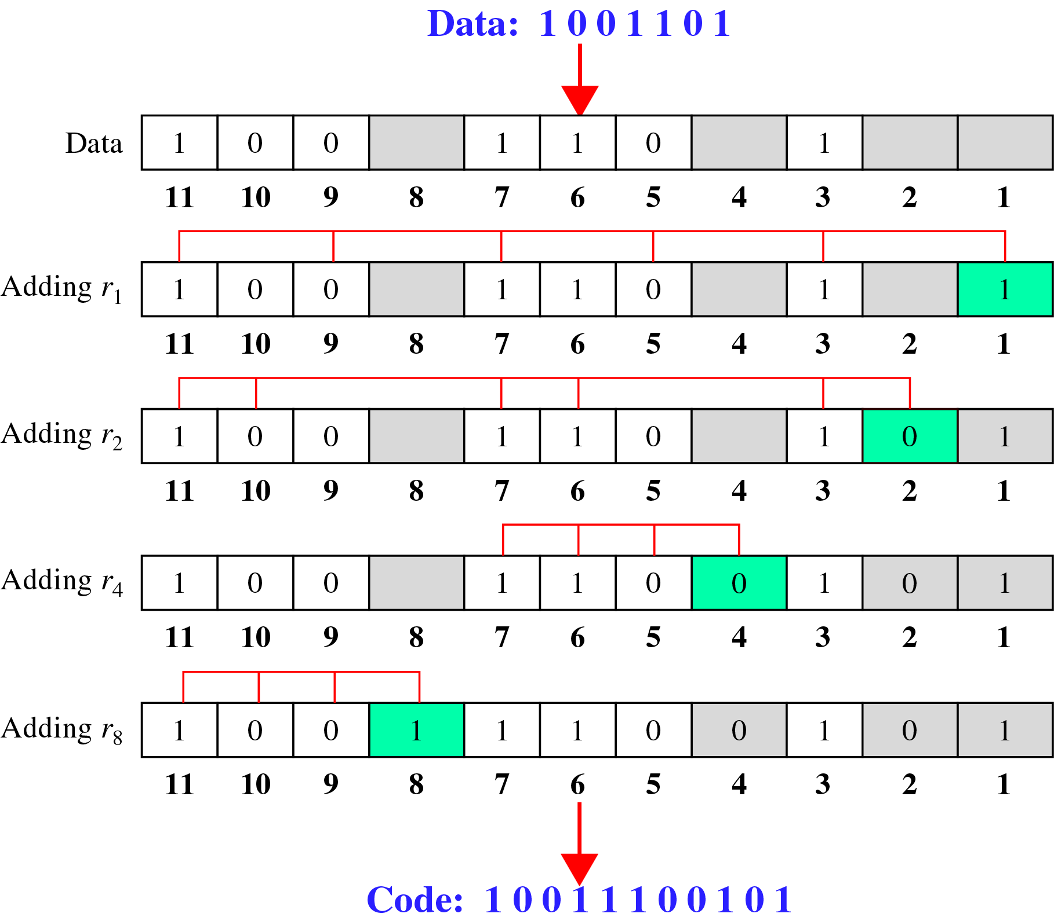
Error Correction(cont’d)
Calculating the r values
Calculating Even Parity

Slide 46
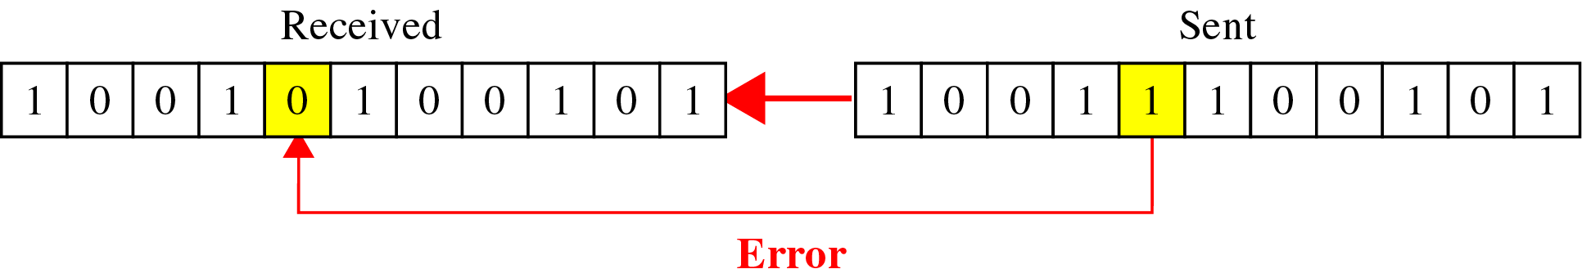
Error Correction(cont’d)
Error Detection and Correction

Slide 47
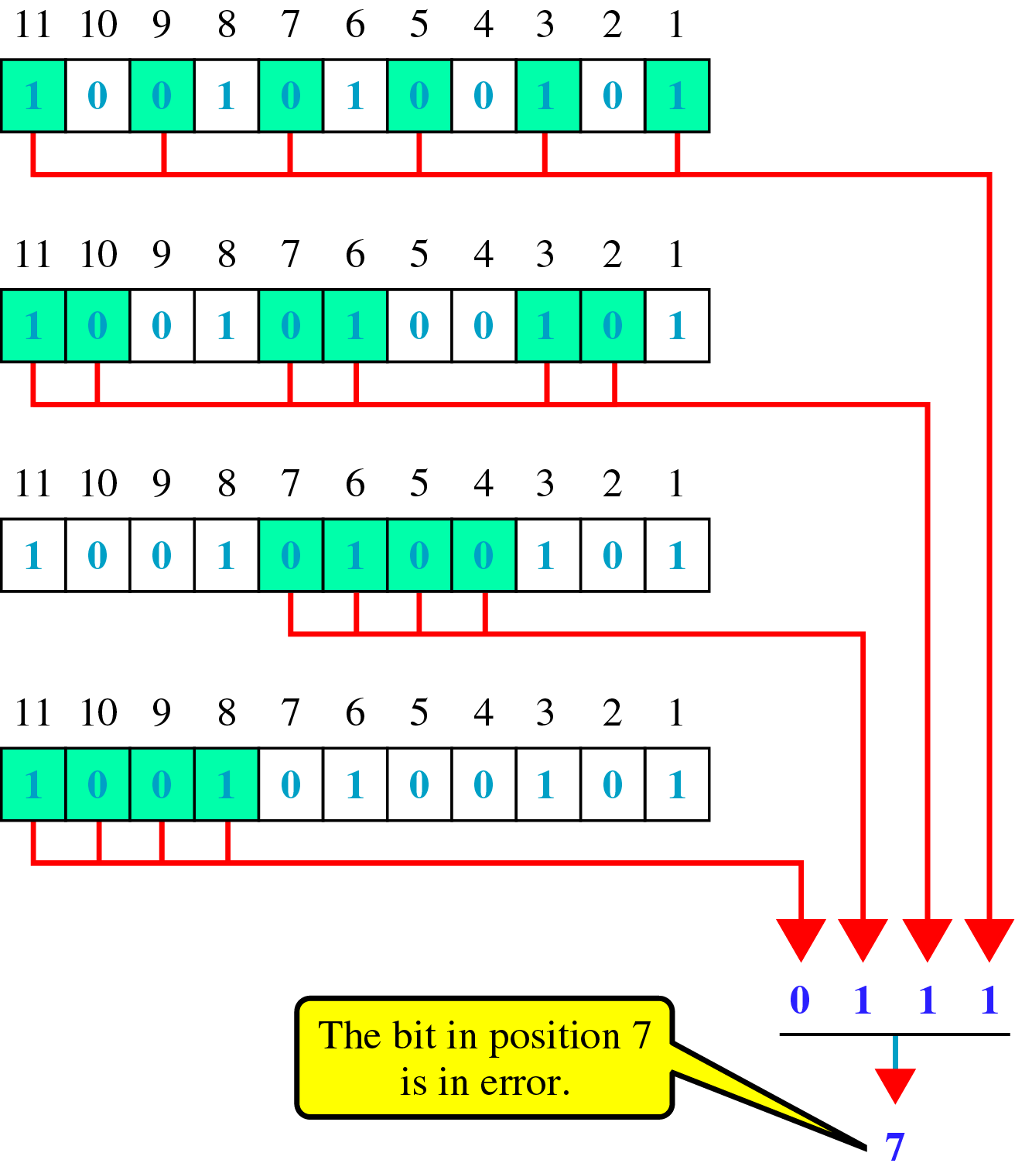
Error Correction(cont’d)
Error detection using Hamming Code

Slide 48
Error Correction(cont’d)
Multiple-Bit Error Correction
  redundancy bits calculated on overlapping sets of data units can also be used to correct multiple-bit errors.
  Ex) to correct double-bit errors, we must take into consideration that two bits can be a combination of any two bits in the entire sequence

